Slide 1
Anvayartha (अन्वयार्थ )
Paraphrasing Tool
For Low Resource Language
Team Members
1. Pranita Barbade
2. Akshada Malpure
3. Anushka Pawar
4. Reena Prasad
Project Mentor
Prof. Pranjali Deshpande
29-05-2023 Anvayartha 1

Slide 2
Index
Problem Statement
Introduction
Literature survey
Motivation
System Design
Implementation Aspects
Project Design
Hardware and Software Requirements
Conclusion
Future Scope
References
29-05-2023 Anvayartha 2

Slide 3
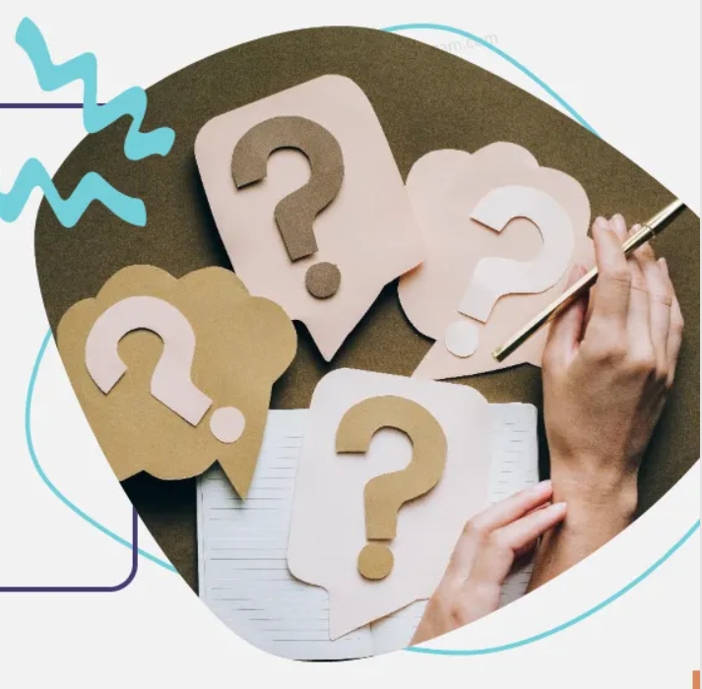
Problem Statement
To create a tool for paraphrasing of low resource language sentence.
29-05-2023 Anvayartha 3

Slide 4
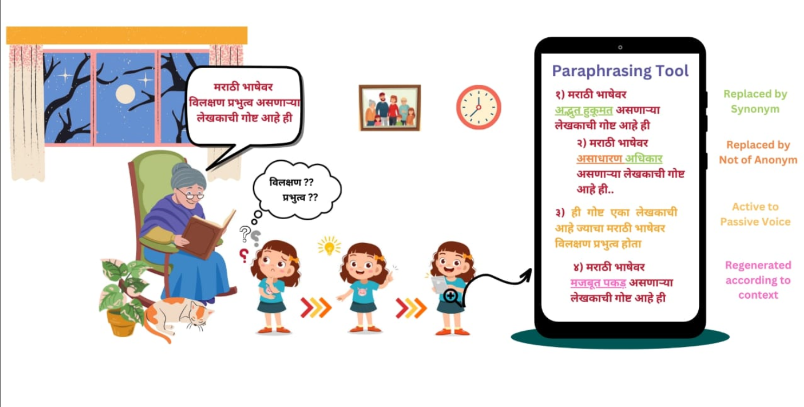

Slide 5
Introduction
Text regeneration(Paraphrasing) is an important segment of Natural language Understanding(NLU), a subpart of Natural Language Processing(NLP).
Paraphrasing is used to express a sentence using different words without changing the meaning of the original sentence.
The proposed tool will perform paraphrasing of low resource language sentence.
29-05-2023 Anvayartha 5

Slide 6

Objectives
Broader Objective:
To create a tool for paraphrasing of low resource language sentence.
Sub-Objectives:
Creating dataset and Data Pre-processing.
Identification of candidate keywords.
Replace the candidate keywords using wordnet.
Evaluation of the multiple paraphrased sentences.
29-05-2023 Anvayartha 6

Slide 7
Literature Review
Paper | Approaches and Techniques Used | Remarks
Indian Journal of Science and Technology, 2016 [2] | The input paragraph is first broken down into sentences, followed by tokenization of sentences into words and appropriate reframing rules are applied for paraphrasing. | Paraphrasing techniques like replacement by synonym or antonym used.
Sprenger, 2021 [3] | LSTM seq2seq transformer converts idiomatic sentence into literal sentence. | Simple pattern matching instead of complete paraphrasing.
Association for Computational linguistics, 2019 [4] | Approach with discriminators and multiple generators to generate a variety of different paraphrases. | Model has better results concerning both diversity and quality
29-05-2023 Anvayartha 7

Slide 8
Literature Review
Paper | Approaches and Techniques Used | Remarks
arXiv, 2019 [5] | Encoder and Decoder model is used and an additional transcoder is used to convert a sentence into its paraphrasing latent code. | This model mainly focuses on pattern matching. Various diverse paraphrased sentences are generated.
arXiv, 2017 [6] | Combination of deep generative models like Variational Autoencoder (VAE) with sequence-to-sequence models (LSTM) to generate paraphrase sentences. | This model is quite simple and modular. Sometimes can give out of context paraphrased sentences.
29-05-2023 Anvayartha 8

Slide 9
Motivation
No credible research in Natural Language Generation for low resource languages (Marathi).
Unavailability of any tool for paraphrasing in Marathi.
Low resource language (Marathi) assistance for language learners
29-05-2023 Anvayartha 9

Slide 10

Scope
Generation of input dataset.
Accessing Wordnet.
Implement various algorithms to identify candidate keywords for paraphrasing.
Evaluating the paraphrased sentences using similarity index.
29-05-2023 Anvayartha 10

Slide 11
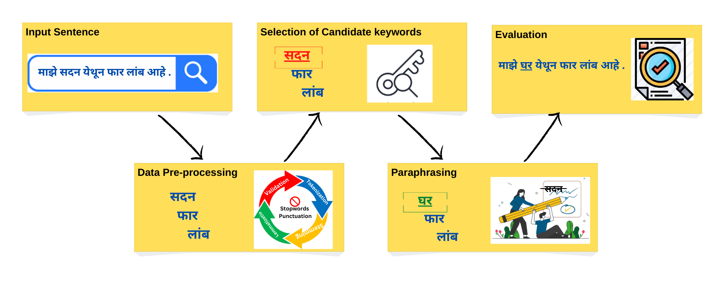
System Design
System Flow Diagram
29-05-2023 Anvayartha 11

Slide 12
Module-wise Description
Input Sentence
User will provide a sentence in Marathi as an Input and if the langdetect library is used to detect the language of input sentence, if it is Marathi only then the sentence is valid else it prompts the user to enter the input sentence in marathi language.
This sentence will further get processed to generate multiple paraphrased sentences.
Data Preprocessing
Initially, the input will go through multiple validation checks.
If it passes the validation then,
Tokenization will be performed on the input sentence.
The tokenized words will be converted into the root words using stemming.
To ensure root words are meaningful with respect to sentence, lemmatization will be performed on them.
29-05-2023 Anvayartha 12

Slide 13
Module-wise Description
Selection of Candidate Keywords
After the Data preprocessing, the keywords are extracted which further help in deciding which methodology should be used like replacement by synonyms or antonyms, active to passive or vice versa.
Paraphrasing
After the appropriate methodology is selected, the tool accesses Wordnet to look for the suitable replacements and the sentences are restructured.
Evaluation
Once the paraphrasing is done, evaluation of the multiple paraphrased sentences will be performed.
The evaluation will show the similarity index between the input sentences and the output paraphrased sentences generated and for evaluation MahaNLP library is used.
29-05-2023 Anvayartha 13

Slide 14
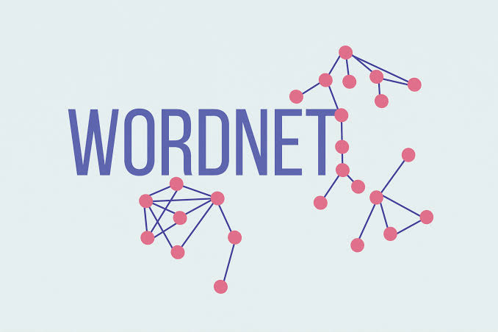
Marathi Wordnet
IndoWordNet[1] : Database for Indian languages
Marathi dataset by Center for Indian Language Technology (CFILT) at IIT Bombay
Follow the principles of minimality, coverage and replaceability for synsets
Uniquely give the concept represented by the synset (minimality)
Synset should cover ALL the words representing the concept in the language (coverage)
Words of the synset should be able to replace one another in reasonable amount of corpora (replaceability)
29-05-2023 Anvayartha 14

Slide 15
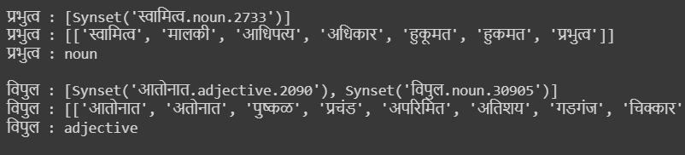
For Example, let’s consider an input sentence as following:
कोणत्याही भाषेवर प्रभुत्व मिळवायच असेल तर आपल्याकडे विपुल शब्दसंग्रह असायला हवा.
From the input sentence, after data pre-processing,
Each word’s synsets, part of speech, synonyms, etc are accessed through the IndoWordnet.
Then, preferably the first priority is given to Adjectives for Paraphrasing.
29-05-2023 Anvayartha 15

Slide 16
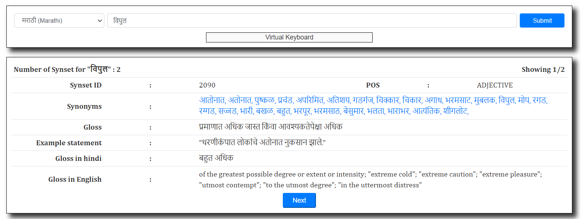
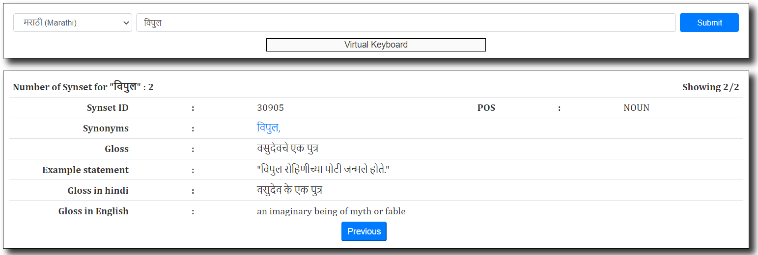
Here’s a Snapshot for the word विपुल when searched on Indowordnet
29-05-2023 Anvayartha 16

Slide 17
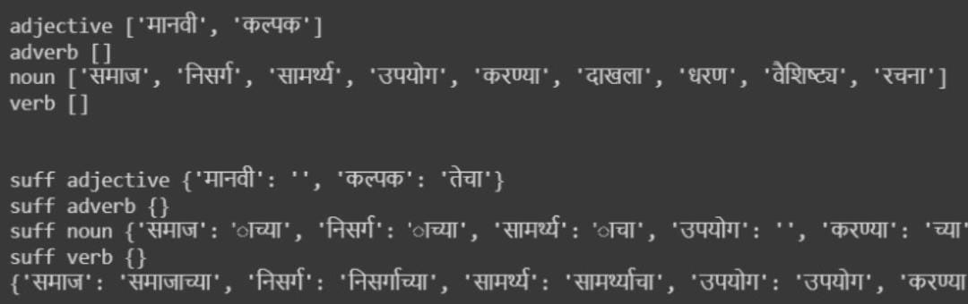
Stemming
Stemming is a natural language processing technique that is used to reduce words to their base form, also known as the root form.
Pywin Library Updation : To get null list for absent word in IndoWordnet
A separate file with a root word and all its forms present in dataset will be created
29-05-2023 Anvayartha 17

Slide 18
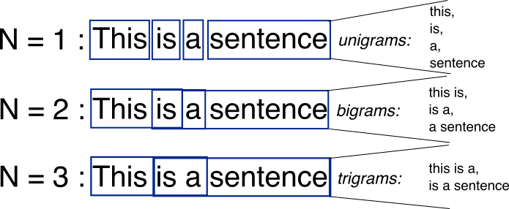
N-gram Technique
N-grams are continuous sequences of words or symbols or tokens in a document.
In technical terms, they can be defined as the neighbouring sequences of items in a document.
An n-gram model is a type of probabilistic language model for predicting the next item in such a sequence in the form of a (n − 1)–order.
29-05-2023 Anvayartha 18

Slide 19
N-gram Technique Implementation
Dataset Creation
Ngram used: 3 (Trigram)
Grams creation:
Unigram: { Word : Freq}
Bigram: { Word, Word : Freq}
Trigram: {Word, Word, Word : Freq}
For eg: Unigram: ['खेळ', 9]
Bigram: ['खेळ कोणताही', '1']
Trigram: ['खेळ कोणताही असो', '1']
CSV File Creation:
Read and Write Operations
Read earlier CSV file and then Update while writing to CSV file.
29-05-2023 Anvayartha 19

Slide 20
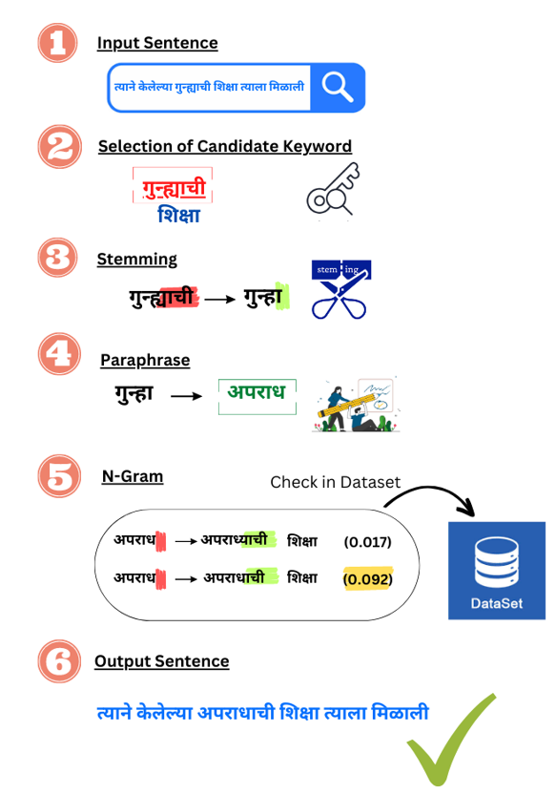
N-gram Technique
Design
29-05-2023 Anvayartha 20

Slide 21
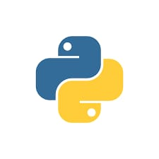


Hardware and Software Requirements
Language : Python
Platform : Google Colab, Spyder
Domain : Natural Language Processing
Tools : Nltk , Marathi Wordnet [1], pyiwn, Tkinter,
MahaNLP, langdetect.
29-05-2023 Anvayartha 21

Slide 22
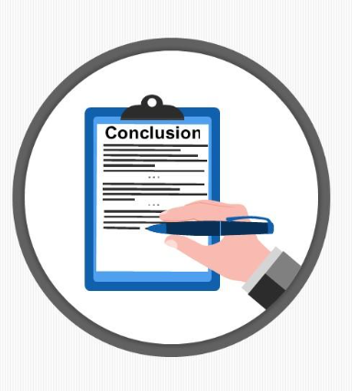
Conclusion
The proposed system will perform paraphrasing of the input sentences given by user and will generate multiple paraphrased sentences.
The reason to build this system is the unavailability of the paraphrasing tool for low resource language(Marathi).
The tool will act as an assistance to the new learners of the low resource language.
This will also help to enrich the literature of the language.
29-05-2023 Anvayartha 22

Slide 23

Future Scope
Lemmatization
Expansion of Dataset
29-05-2023 Anvayartha 23

Slide 24
References
[1] Marathi wordnet IIT Bombay: https://www.cfilt.iitb.ac.in/MobileMarathiWordnet/menglish_version.php
[2] Nandini Sethi, Prateek Agrawal*, Vishu Madaan and Sanjay Kumar Singh.2016. A novel approach to paraphrase hindi sentences using natural language processing
[3] Jianing Zhou, Hongyu Gong, Srihari Nanniyur, and Suma Bhat. 2021b. From solving a problem boldly to cutting the gordian knot: idiomatic text generation. Arxiv preprint arxiv:2104.06541
[4] Lihua Qian, Lin Qiu, Weinan Zhang, Xin Jiang, and Yong Yu. 2019. Exploring diverse expressions for paraphrase generation. In proceedings of the 2019 conference on empirical methods in natural language processing and the 9th international joint conference on natural language processing (emnlp-ijcnlp), pages 3164–3173.
[5] Zhecheng An and Sicong Liu. 2019. Towards diverse paraphrase generation using multi-class wassersteingan. Arxiv preprint arxiv:1909.13827.
[6] Ankush Gupta, Arvind Agarwal, Prawaan Singh, and Piyush Rai. 2017. A deep generative framework for paraphrase generation. Arxiv preprint arxiv:1709.05074.
29-05-2023 Anvayartha 24

Slide 25
Thank You !
29-05-2023 Anvayartha 25

